Slide 1
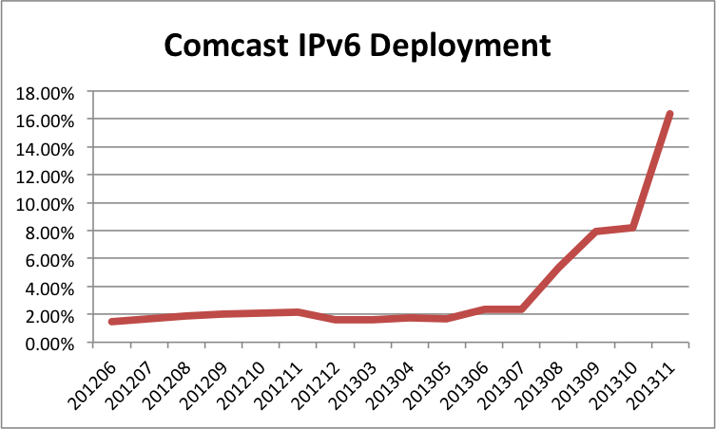
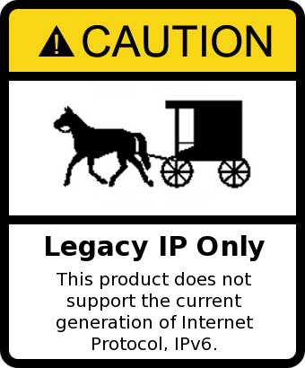

IPv6 Live
-or-
Current State and Demonstration of IPv6
James Small, Sr. Consultant at AT&T

Slide 2

Overview Objectives
Brief Why IPv6 and Current Landscape
Getting IPv6 Up and Running
IPv6 Reference and Parting Thoughts
Q&A throughout, I may postpone questions until the end depending on time

Slide 3

Why IPv6?
Optimal Gaming Experience
For the best possible user experience, Xbox users should use IPv6 connectivity.
– Christopher Palmer, Program Manager, Networking Core/Operating System Group

Slide 4
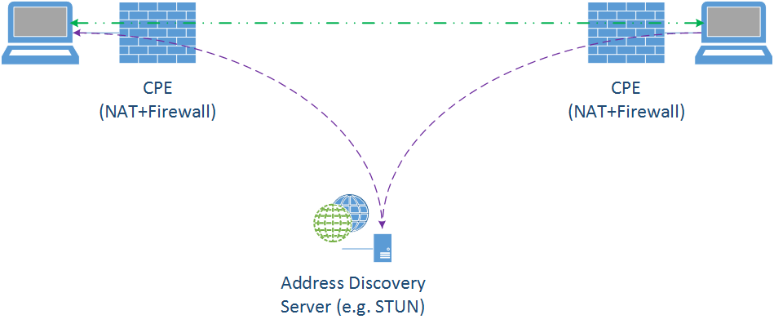
Why is IPv6 better for gaming?
Simple IPv4 Example
Internet Server required for public address resolution

Slide 5
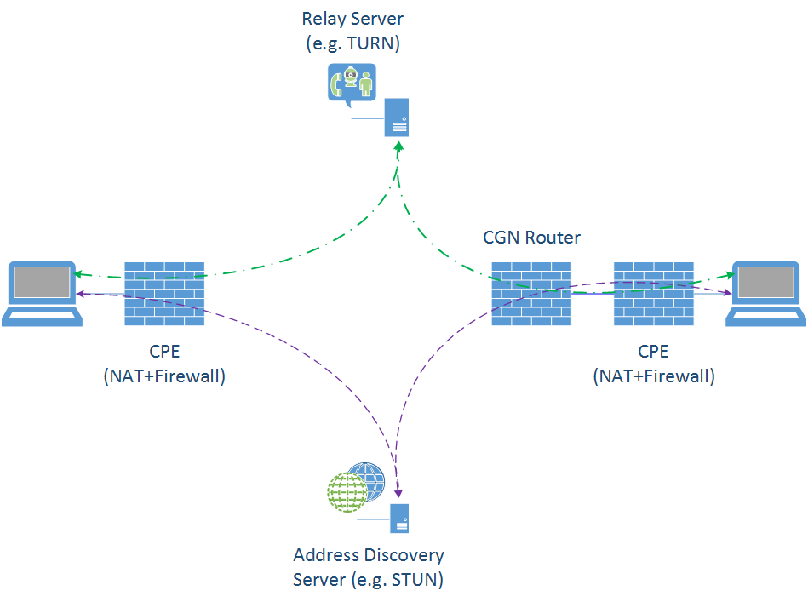
Why is IPv6 better for gaming?
More Typical IPv4 Example
Internet Server required for public address resolution
STUN fails because of unsupported NAT setup
Relay Server must be used
Relaying adds latency
Scale/speed/reliability dependent on relay service

Slide 6
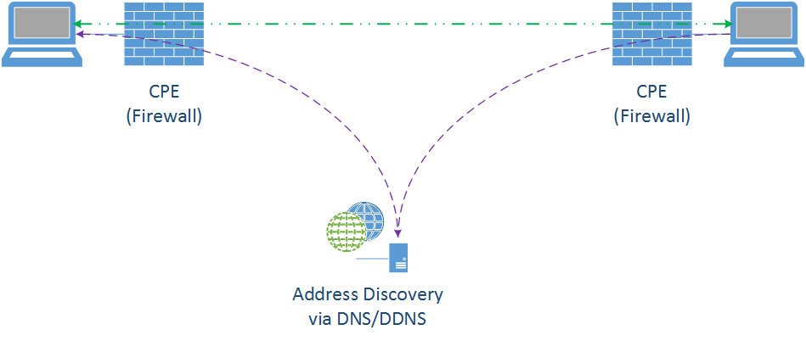
Why is IPv6 better for gaming?
Typical IPv6 Example
DNS used for address resolution!
At most, only a Dynamic DNS solution is required – many public ones readily available for free.

Slide 7
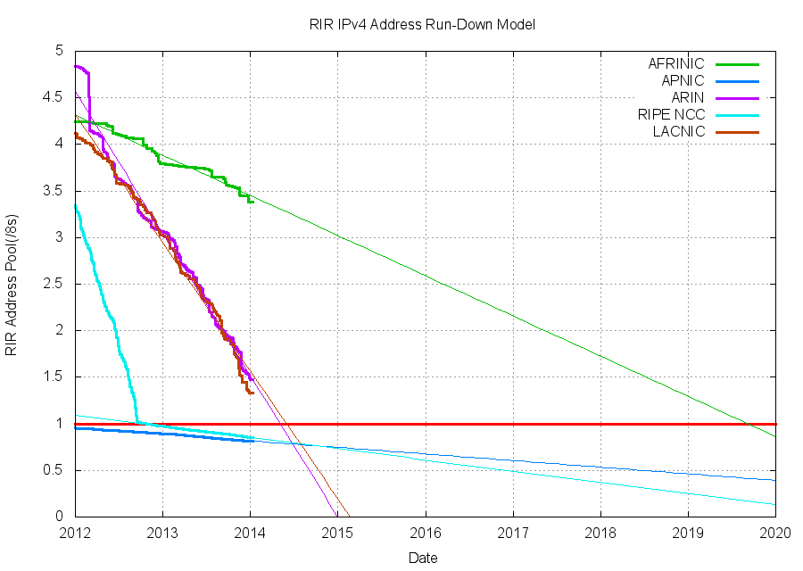
Current IPv4 status – Depletion
IANA Free Pool Depletion – February, 2011
APNIC (Asia/Pacific) Depletion – April, 2011
RIPE (Europe/Middle East) Depletion – September, 2012
ARIN (US/Canada) Depletion – ETA of Q1 2015
Less than 25 million addresses remaining
In 2012, ARIN handed out 45 million addresses
Address allocation slowing because of CGN and addressing markets
Massive growth coming from:
Population penetration
Mobile device explosion
Internet of Things (all electronic devices – light bulbs, sensors, tags)

Slide 8
Current ipv6 status – deployment
Major Carrier Deployment Status
Google Fiber 70.22%
Virginia Tech 61.69%
SPAWAR (US DOD) 51.12%
Verizon Wireless 40.40%
Comcast 20.15%
AT&T 14.82%
T-Mobile USA 6.49%
US Overall IPv6 Penetration:
5.74% (fluctuates up to 6.25%)
US Weighted Web Content available via IPv6: 44.91%
T-Mobile Goes IPv6 Only on Android 4.4 Devices using 464XLAT

Slide 9
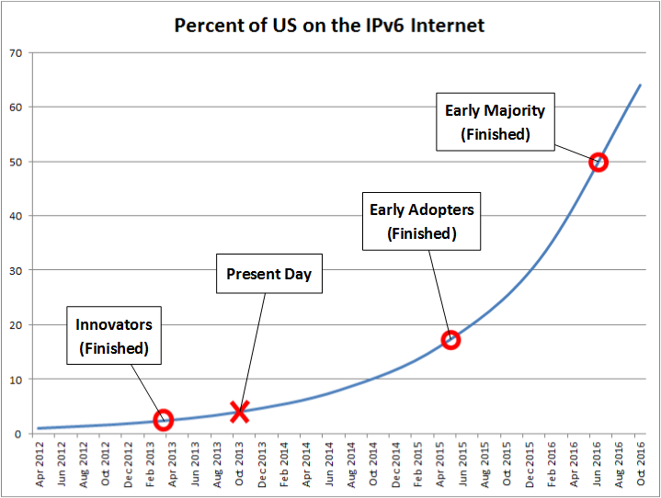
Current ipv6 penetration projection

Slide 10

Roadmap
Brief Why IPv6 and Current Landscape
Getting IPv6 Up and Running
IPv6 Reference and Parting Thoughts
Notes:
Should be here at around 5 minutes

Slide 11
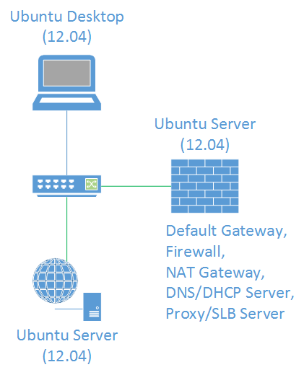
IPv6 Test Setup
Using Linux
Using the Ubuntu Distro
Using the LTS Build
Used all VMs
Hypervisor ESX 5.1

Slide 12
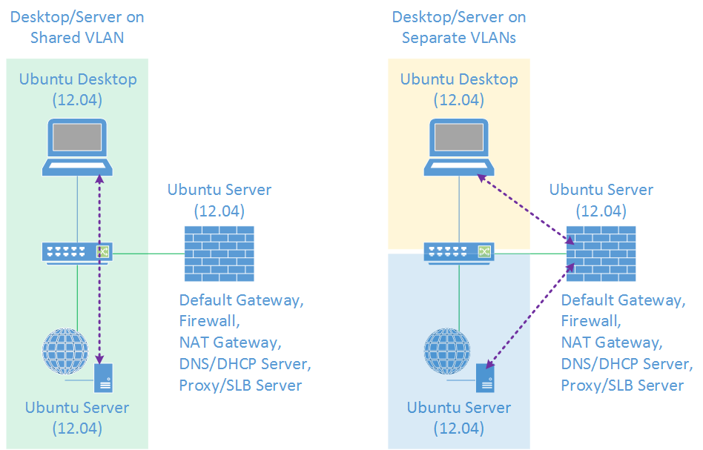
Ipv6 Test topologies

Slide 13
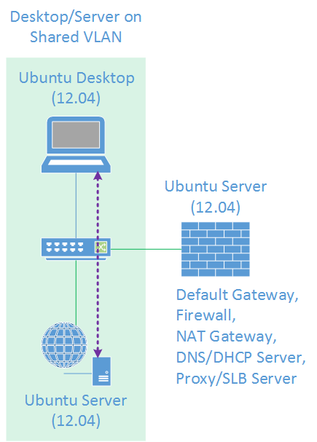
Initial ipv6 setup
Default setup
No IPv6 explicitly configured
Let’s look at the defaults:
root@v6client:~# ifconfig -a
lo Link encap:Local Loopback
inet addr:127.0.0.1 Mask:255.0.0.0
inet6 addr: ::1/128 Scope:Host
UP LOOPBACK RUNNING MTU:65536 Metric:1
(…)
eth0 Link encap:Ethernet HWaddr 00:50:56:8f:2a:54
inet addr:192.168.231.11 Bcast:192.168.231.255 Mask:255.255.255.0
inet6 addr: fe80::250:56ff:fe8f:2a54/64 Scope:Link
UP BROADCAST RUNNING MULTICAST MTU:1500 Metric:1
(…)

Slide 14
Initial ipv6 setup
Default setup
No IPv6 explicitly configured
Let’s look at the defaults:
root@v6client:~# ifconfig -a
lo Link encap:Local Loopback
inet addr:127.0.0.1 Mask:255.0.0.0
inet6 addr: ::1/128 Scope:Host
UP LOOPBACK RUNNING MTU:65536 Metric:1
(…)
eth0 Link encap:Ethernet HWaddr 00:50:56:8f:2a:54
inet addr:192.168.231.11 Bcast:192.168.231.255 Mask:255.255.255.0
inet6 addr: fe80::250:56ff:fe8f:2a54/64 Scope:Link
UP BROADCAST RUNNING MULTICAST MTU:1500 Metric:1
(…)

Slide 15

A quick step back

Slide 16
IPv4 versus ipv6 addressing
Type | IPv4 | IPv6
Unspecified | 0.0.0.0 | ::
Loopback | 127.0.0.1 | ::1
“Link-Local” | 169.254.251.1 | fe80::584c:7cf5:4a0e:3ce9%eth0
“Private” | 10.152.16.87 | fd8d:8b76:0494:659b::4ae:3ce9
Public | 12.203.95.104 | 2001:46e:cae8::a7:1afe:e91d
Multicast | 224.0.0.18 | ff02::1:ff94:e774
“Broadcast” | 255.255.255.255 | ff02::1

Slide 17
Initial ipv6 setup
Configure IPv6 address:
root@v6client:~# ifconfig eth0 inet6 add 2001:db8:1::1011/64
root@v6client:~# ifconfig eth0
(…)
inet6 addr: 2001:db8:1::1011/64 Scope:Global
(…)
-or-
root@v6client:~# ip addr add 2001:db8:1::1011/64 dev eth0
root@v6client:~# ip addr show dev eth0
(…)
inet6 2001:db8:1::1011/64 scope global
valid_lft forever preferred_lft forever
(…)

Slide 18
ipv6 address structure
Hexadecimal digits (0-9, a-f)
8 groups of 16 bit (4 digit) numbers
Groups separated by colons (:)
Digits not case sensitive, but lower case preferred
Abbreviations are possible
Can omit leading zeroes
Can substitute longest string of zeroes with double colon (::)
Examples:
2001:db8:cafe:f0a2:a8b0:2:ffe1:a90b
fd92:e075:819c:7a2::fc9a:105
fe80::f413:9b1e:9f3:feb6
ff05::fb

Slide 19
ipv6 addressing basics
IPv6 prefixes/addresses always use CIDR notation:
IPv4 – 192.0.2.0/24
IPv6 – 2001:db8:101::/48
IPv6 addresses can omit leading zeroes, but not trailing ones:
2001:0db8:0101:00a0:0000:0000:0d20:9ce5
Becomes:
2001:db8:101:a0:0:0:d20:9ce5
But Not (Just like 010 = 10, but 010 ≠ 1, 010 ≠ 01)
2001:db8:101:a:0:0:d2:9ce5
2001:db8:101:00a:0:0:0d2:9ce5
IPv6 addresses can substitute longest string of zeroes with a double colon:
2001:db8:101:a0::d20:9ce5

Slide 20
ipv6 addressing
Link Local – fe80::/10 (link only significance)
Unique Local – fc00::/7 (not routable on Internet)
Global – 2000::/3 (currently IANA allocated address space)
Currently:
All global IPv6 addresses are currently allocated from 2000::/3
In other words – 2000-3fff::
Out of that, only 2000-2c0f:: has been assigned
Bottom line – for now you will only see global IPv6 addresses starting with “2”
Documentation prefix
2001:db8::/32 is reserved for documentation/examples, not routed on the Internet

Slide 21
IPv6 Changes from IPv4
Broadcasts
ARP replaced by NDP, a subset of ICMPv6
Nodes can auto-configure address with SLAAC (use RAs)
DHCP replaced by RAs (subset of NDP) + DHCPv6
Blocking ICMPv6 will completely break IPv6!!!
Careful with firewall/route/switch/operating system ACLs
Minimum MTU changes from 68 to 1280
Fragmentation only done by end nodes, not by routers

Slide 22
No more broadcasts
Why not?
Most common link layer – Ethernet
Broadcast sent to all on-link nodes regardless of need
Node doesn’t use protocol? Too bad…
Node isn’t interested in traffic? Too bad…
Inefficient
The source of many problems
Broadcast storms
Scalability issues
Replaced with Multicast

Slide 23
No more broadcasts
Broadcast replacement is link-local multicast:
ff02::1 – All nodes on the link
Each application has its own group address
ff02::2 – All routers
ff02::fb – mDNSv6
ff02::1:2 – All DHCPv6 agents
Only interested nodes join the group
IPv6 brings scoping
No more choosing between network security/stability and handy broadcast features
Directed broadcasts for features like Wake on LAN will be replaced with scoped multicast

Slide 24
Initial ipv6 Multicast Groups?
Default setup
No IPv6 explicitly configured
Let’s look at the defaults:
root@v6client:~# ip -6 maddr show
1: lo
inet6 ff02::1
2: eth0
inet6 ff02::1
inet6 ff02::fb
inet6 ff02::1:ff8f:2a54

Slide 25
IPv6 Changes from IPv4
Broadcasts
ARP replaced by NDP, a subset of ICMPv6
Nodes can auto-configure address with SLAAC (use RAs)
DHCP replaced by RAs (subset of NDP) + DHCPv6
Blocking ICMPv6 will completely break IPv6!!!
Careful with firewall/route/switch/operating system ACLs
Minimum MTU changes from 68 to 1280
Fragmentation only done by end nodes, not by routers

Slide 26
IP L2 Address resolution
IPv4 L2 Cache:
root@v6client:~# arp -a
v6client.local (192.168.231.11) at 00:0c:29:e9:bc:50 [ether] on eth0
v6server.local (192.168.231.12) at 00:26:2d:fc:05:9b [ether] on eth0
v6gateway.local (192.168.231.13) at 00:00:0c:9f:f0:65 [ether] on eth0
IPv6 L2 Cache:
root@v6client:~# ip -6 neigh show
fe80::301:1 dev eth0 lladdr 00:05:73:a0:00:66 router STALE
2001:db8:c3:f1:3fd:6182:d9b6:b027 dev eth0 lladdr 00:26:2d:fc:05:9b REACHABLE
2001:db8:c3:f1::101:a861 dev eth0 lladdr 00:0c:29:80:a8:61 STALE

Slide 27
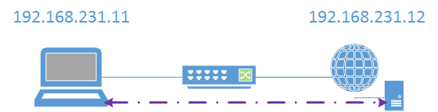
IPv4 L2 address resolution (review)
Client (192.168.231.11) needs to talk to server (192.168.231.12)
Client needs MAC Address (L2) for server
Client uses ARP to resolve IPv4 Address (L3) to MAC Address (L2)
ARP uses broadcast – who owns the IPv4 Address 192.168.231.12?
Note: ARP is a L2 protocol, does not use IPv4

Slide 28
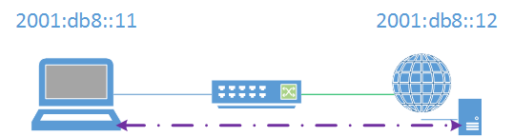
IPv6 L2 address resolution
Client (2001:db8::11) needs to talk to server (2001:db8::12)
Client needs MAC Address (L2) for server
Client uses NDP to resolve IPv6 Address (L3) to MAC Address (L2)
NDP uses ICMPv6 which uses a special multicast group – who owns the IPv6 Address 2001:db8::12?
Note: NDP/ICMPv6 is a L3 protocol, uses IPv6

Slide 29
IPv6 L2 address resolution
NDP uses a special multicast group for L3 to L2 address resolution – the solicited node multicast address:
ff02:0:0:0:0:1:ff/104
NDP takes the last 24 bits of the address it needs L2 info for and appends it:
Server Address: 2001:db8::12 (2001:db8::00:0012)
Solicited Node Address: ff02::1:ff00:12
Much more scalable that ARP!

Slide 30
IPv6 L2 address mechanics
An IPv6 node will join the solicited node multicast address group for each interface address:
root@v6client:~# ip -6 addr show dev eth0
2: eth0: <BROADCAST,MULTICAST,UP,LOWER_UP> mtu 1500 qlen 1000
inet6 2001:db8:1::1011/64 scope global
valid_lft forever preferred_lft forever
inet6 fe80::250:56ff:fe8f:2a54/64 scope link
valid_lft forever preferred_lft forever
root@v6client:~# ip -6 maddr show dev eth0
2: eth0
inet6 ff02::fb
inet6 ff02::1:ff00:1011
inet6 ff02::1:ff8f:2a54
inet6 ff02::1

Slide 31
IPv6 Changes from IPv4
Broadcasts
ARP replaced by NDP, a subset of ICMPv6
Nodes can auto-configure address with SLAAC (use RAs)
DHCP replaced by RAs (subset of NDP) + DHCPv6
Blocking ICMPv6 will completely break IPv6!!!
Careful with firewall/route/switch/operating system ACLs
Minimum MTU changes from 68 to 1280
Fragmentation only done by end nodes, not by routers

Slide 32
Enable IPv6 router
Enable IPv6 routing on gateway host – preparation:
Note: radvd not present
root@v6gateway:~# apt-get install radvd
# Enable IPv6 routing
root@v6gateway:~# sysctl net.ipv6.conf.all.forwarding
net.ipv6.conf.all.forwarding = 0
root@v6gateway:~# sysctl -w net.ipv6.conf.all.forwarding=1
net.ipv6.conf.all.forwarding = 1

Slide 33
Enable IPv6 router
Enable IPv6 routing on gateway host – preparation:
# Setup radvd.conf:
interface eth0 {
AdvSendAdvert on;
AdvManagedFlag off; # Enable for stateful DHCPv6
AdvOtherConfigFlag off; # Enable for stateless DHCPv6
# AdvLinkMTU 1480; # If needed (e.g. tunnels)
prefix 2001:db8:1::/64 {
AdvOnLink on;
AdvAutonomous on;
};
RDNSS 2001:4860:4860::8888 2001:4860:4860::8844 {
};
DNSSL test.local {
};
};

Slide 34
Enable IPv6 router
Enable IPv6 routing on gateway host – preparation:
# Start radvd
service radvd start
# Let’s look at a previously unconfigured client
# on the same link:
root@v6client:~# ifconfig eth0
eth0 Link encap:Ethernet HWaddr 00:50:56:8f:2a:54
(…)
inet6 addr: 2001:db8:1:0:19ed:b935:f346:30e2/64 Scope:Global
inet6 addr: fe80::250:56ff:fe8f:2a54/64 Scope:Link
inet6 addr: 2001:db8:1:0:250:56ff:fe8f:2a54/64 Scope:Global
(…)

Slide 35
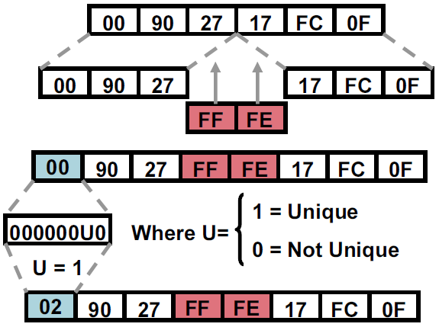
ipv6 interface addressing
Always 64 bits – Why?
IEEE hands out 48 bit (EUI-48) and 64 bit (EUI-64) MACs
Original idea was to use MAC to generate IID like in IPX
For 48 bit MACs, you insert 0xFFFE in the middle to generate a 64 bit address (IEEE Rule)
The “U” bit is also flipped (Modified EUI-64) This is so if you create a local address you can use 2001:db8::1 instead of 2001:db8::0200:0:0:1 Wasn’t that nice of them?

Slide 36
IPv6 addresses – Slaac
When we enabled the Router Advertisement Daemon (radvd), we enabled SLAAC for the link
SLAAC – StateLess Address Auto-Configuration
Idea is to make IPv6 more plug-in-play like IPX
Compare IPv6 Addresses to MAC Address:
00:50:56:8f:2a:54 should be 0250:56ff:fe8f:2a54
root@v6client:~# ifconfig eth0
eth0 Link encap:Ethernet HWaddr 00:50:56:8f:2a:54
(…)
inet6 addr: 2001:db8:1:0:19ed:b935:f346:30e2/64 Scope:Global
inet6 addr: fe80::250:56ff:fe8f:2a54/64 Scope:Link
inet6 addr: 2001:db8:1:0:250:56ff:fe8f:2a54/64 Scope:Global
(…)
?
√

Slide 37
ipv6 addresses – slaac
The ip command is more useful for examing IPv6 Addresses:
root@v6client:~# ip -6 addr show dev eth0
2: eth0: <BROADCAST,MULTICAST,UP,LOWER_UP> mtu 1500 qlen 1000
inet6 2001:db8:1:0:19ed:b935:f346:30e2/64 scope global temporary dynamic
valid_lft 85910sec preferred_lft 13910sec
inet6 2001:db8:1:0:250:56ff:fe8f:2a54/64 scope global dynamic
valid_lft 85910sec preferred_lft 13910sec
inet6 fe80::250:56ff:fe8f:2a54/64 scope link
valid_lft forever preferred_lft forever
What’s a temporary address?

Slide 38
ipv6 interface addressing
Modified EUI-64 was originally used for Stateless Auto Address Configuration (SLAAC)
Unfortunately M-EUI-64 based addresses can be used as a super cookie
To address this, privacy extensions were created (RFC 4941)
Privacy Extensions
Nodes use a rotating, temporary address for outgoing communication
The address changes periodically – typically once/day by default
When creating the IID, a random number is used instead of the M-EUI-64 process
This solves the “cookie” problem

Slide 39
ipv6 privacy addressing
Privacy Addressing in Linux:
sysctl net.ipv6.conf.all.use_tempaddr
use_tempaddr - Privacy Extensions Configuration
<= 0 : disable Privacy Extensions
== 1 : enable Privacy Extensions, but prefer public addresses over temporary addresses
> 1 : enable Privacy Extensions and prefer temporary addresses over public addresses
Note: Default in Ubuntu 12.04 is 2
Privacy addresses are great for consumers but problematic for the enterprise
DHCPv6 relays don’t include client MAC address
Privacy addresses make accountability/security difficult because addresses periodically rotate/change

Slide 40
IPv6 Changes from IPv4
Broadcasts
ARP replaced by NDP, a subset of ICMPv6
Nodes can auto-configure address with SLAAC (use RAs)
DHCP replaced by RAs (subset of NDP) + DHCPv6
Blocking ICMPv6 will completely break IPv6!!!
Careful with firewall/route/switch/operating system ACLs
Minimum MTU changes from 68 to 1280
Fragmentation only done by end nodes, not by routers

Slide 41
DHCPv6
DHCPv6 setup requires several components
Local router advertising to use DHCPv6
Stateless DHCP
# radvd.conf:
interface eth0 {
AdvOtherConfigFlag on; # Enable for stateless DHCPv6
Stateful DHCP
AdvManagedFlag on; # Enable for stateful DHCPv6
DHCPv6 server
Optionally DHCPv6 relays

Slide 42
DHCPv6 server
DHCPv6 server setup - stateless
# DHCPv6 Parameters:
subnet6 2001:db8:1::/64 {
# Options
option dhcp6.name-servers 2001:4860:4860::8888;
option dhcp6.domain-search "test.local";
}
Start:
dhcpd -6 -cf <PATH-to-configfile> -lf <PATH-to-leasefile>

Slide 43
DHCPv6 server
DHCPv6 server setup - stateful
# DHCPv6 Parameters:
subnet6 2001:db8:1::/64 {
# Range for clients
range6 2001:db8:1::2000 2001:db8:1::2fff;
}
Start:
dhcpd -6 -cf <PATH-to-configfile> -lf <PATH-to-leasefile>

Slide 44
IPv6 Changes from IPv4
Broadcasts
ARP replaced by NDP, a subset of ICMPv6
Nodes can auto-configure address with SLAAC (use RAs)
DHCP replaced by RAs (subset of NDP) + DHCPv6
Blocking ICMPv6 will completely break IPv6!!!
Careful with firewall/route/switch/operating system ACLs
Minimum MTU changes from 68 to 1280
Fragmentation only done by end nodes, not by routers

Slide 45
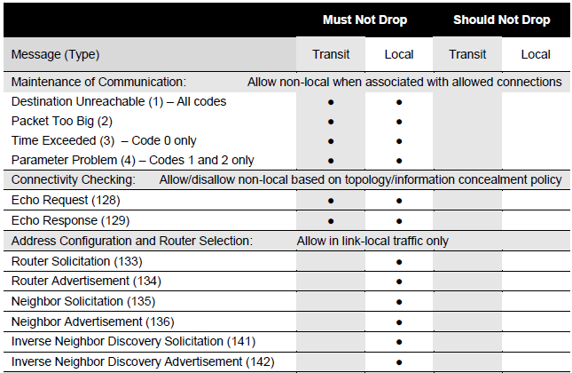
ipv6 access control
Reference NIST SP 800-119 (Section 3.5, Table 3-7)
Reference RFC 4890 (Recommendations for Filtering ICMPv6 Messages in Firewalls)

Slide 46
IPv6 Changes from IPv4
Broadcasts
ARP replaced by NDP, a subset of ICMPv6
Nodes can auto-configure address with SLAAC (use RAs)
DHCP replaced by RAs (subset of NDP) + DHCPv6
Blocking ICMPv6 will completely break IPv6!!!
Careful with firewall/route/switch/operating system ACLs
Minimum MTU changes from 68 to 1280
Fragmentation only done by end nodes, not by routers

Slide 47
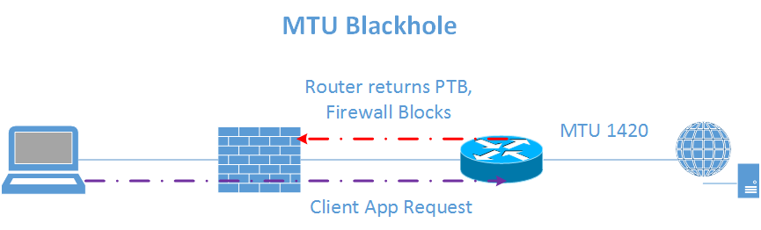
IPv6 Path MTU Blackhole
Client starts application (e.g. browser) which talks to server
The server link has a lower MTU
The intermediate router sends back an ICMPv6 Packet Too Big reply
An intermediate firewall blocks all ICMPv6 traffic creating a Path MTU Blackhole

Slide 48
Roadmap
Brief Why IPv6 and Current Landscape
Getting IPv6 Up and Running
IPv6 Reference and Parting Thoughts
Notes:
Should be here at around 5 minutes

Slide 49
Ipv6 and DNS
DNS has supported IPv6 for a long time – only a new resource record for the address and alternate pointer name space:
IPv4 – A Record:
arin.net. IN A 192.149.252.75
IPv6 – AAAA Record:
arin.net. IN AAAA 2001:500:4:13::80
IPv4 – PTR Record:
75.252.149.192.in-addr.arpa. IN PTR www.arin.net.
IPv6 – PTR Record:
0.8.0.0.0.0.0.0.0.0.0.0.0.0.0.0.3.1.0.0.4.0.0.0.0.0.5.0.1.0.0.2.ip6.arpa. IN PTR www.arin.net.
Transport agnostic - works equally well over IPv4 or IPv6, careful!

Slide 50
multi-protocol realities
IPv4 Firewall
# iptables -nL
Chain INPUT (policy ACCEPT)
target prot opt source destination
ACCEPT icmp -- 0.0.0.0/0 0.0.0.0/0
ACCEPT all -- 0.0.0.0/0 0.0.0.0/0 state RELATED,ESTABLISHED
ACCEPT tcp -- 0.0.0.0/0 0.0.0.0/0 tcp dpt:22
IPv6 Firewall
root@ubuntu12:~# ip6tables -nL
Chain INPUT (policy ACCEPT)
target prot opt source destination
ACCEPT icmpv6 ::/0 ::/0
ACCEPT all ::/0 ::/0 state RELATED,ESTABLISHED
ACCEPT tcp ::/0 ::/0 tcp dpt:80
IPv4 and IPv6 are ships in the night!

Slide 51
Linux IPv6 Tools
General:
ping → ping6
traceroute → traceroute6
tracepath → tracepath6
More:
host/nslookup/dig – same tool, may have to specify IPv6 records (e.g. AAAA)
telnet (still useful for raw connection to service) - same
ssh - same
Network Analysis:
tcpdump – only filtering options change
wireshark – only filtering options change

Slide 52
linux ipv6 tool quirks
IPv6 literals (RFC 3986)
Generally means enclose the IPv6 address in brackets:
2001:db8:fb::1a → [2001:db8:fb::1a]
Necessary or many programs will interpret colons as port number delimeter
Much more “interesting” if you use link local or multicast as you must specify the interface with a zone identifier
Examples:
wget http://[2001:500:4:13::80] – works fine
curl http://[2001:500:4:13::80] – doesn’t work:
curl: (3) [globbing] error: bad range specification after pos 9
Known issue, must use “-g”:
curl -g http://[2001:500:4:13::80]

Slide 53
Linux Ipv6 Guidance
Start with the Linux IPv6 How To:
http://www.tldp.org/HOWTO/Linux+IPv6-HOWTO/index.html
Many things depend on the distro – check out wikis/documentation:
Ubuntu: https://wiki.ubuntu.com/IPv6
Debian: http://madduck.net/docs/ipv6/

Slide 54

A Word of Caution on NAT
NAT use cases:
Address Conservation
Topology Hiding
Path Symmetry
Provide some independence from ISP
Simple/Limited Multihoming
Restricts inbound connections
New
Address Family translation

Slide 55
A Word of Caution on NAT
NAT Challenges
Adds complexity/operational overhead
Many applications use embedded addresses which is broken by NAT
Many applications require ALG to work through NAT
As applications are upgraded, ALG must be too
Loss of end to end connectivity/visibility
Make troubleshooting/auditing/attribution much harder

Slide 56
IPv6 Address provisioning thoughts
Address Options and Applicable Systems:
Pure Static (Must disable SLAAC)
Static with Options
SLAAC, no DHCPv6
Basic
RDNSS
Dynamic VLAN Assignment
SLAAC with (Stateless) DHCPv6
DHCPv6 (Stateful DHCPv6)
Still requires SLAAC for default gateway
Notes:
SLAAC or Stateless Address Auto Configuration allows IPv6 nodes to automatically configure themselves with an IPv6 address when a router on their link or network advertises the appropriate network to use
As you start entering IPv6 forward and reverse DNS records you will find it quite tedious.
You may want to look at an IPAM solution. For those with perpetual Microsoft licensing, Microsoft has what looks to be a pretty slick IPAM solution built-in to Server 2012. There are also many third party IPAM solutions including Infoblox.
Static (no dynamic options)
Infrastructure devices (routers, firewalls, etc.)
Key infrastructure servers (DNS, DHCPv6, Active Directory)
Static (use SLAAC for default gateway and/or DNS)
Option 1 for Servers
SLAAC, no DHCPv6
Some systems (Android) can only do SLAAC
Some systems support RDNSS but not stateless DHCPv6 (Ubuntu Linux)
Ideally use a something like Cisco’s ISE that can assign devices that don’t do DHCPv6 to a SLAAC VLAN
SLAAC with (Stateless) DHCPv6
Possibility for guest networks
DHCPv6 (Stateful DHCPv6)
General recommendation for the enterprise
Provides much more control over addressing
Provides accountability and stable addressing – especially important for Apple iOS devices which churn through too many addresses with SLAAC
Option 2 with reservations for Servers*
*Really?!? Servers without static addressing? Yes – some organizations have successfully used this approach. Don’t let IPv4 constrain your thinking!

Slide 57

Build Your IPv6 DMZ
In order of preference:
Option 1 – Dual Stack
Option 2 – Load balanced (SLB64)
Option 3 – Dual Stack Reverse Proxy
Option 4 (Discouraged) – Use NAT64
Notes:
Again, dual stack means both IPv4 and IPv6 simultaneously
Where dual stack isn’t possible you can look at load balancing; for things like web traffic you can have the load balancer insert an X Forwarded For header with the real IPv6 client address; careful with the XFF header though – you will need to make sure your systems/applications can deal with it
NAT64 may seem appealing but it has many subtle gotchas and drawbacks – remember that IPv4 and IPv6 are different protocols with different inner workings; when you do NAT and essentially try to pretend that they are similar protocols you can have hard to troubleshoot problems such as Path MTU
In order of preference:
Option 1 – Dual Stack for border router(s), firewall(s), and server(s)
Option 2 – Use load balancer(s) (IPv6 towards Internet, IPv4 towards servers)
Option 3 – Use dual stack reverse proxy (IPv6 towards Internet, IPv4 towards servers*)
Option 4 (Discouraged) – Use NAT64 (Operationally complex to troubleshoot and maintain)
*Some questions about solution security

Slide 58

Build Your IPv6 internal Network
Connect Internal IPv6 Network to IPv6 Internet
Option 1 (Preferred) – Dual Stack
Option 2 – Forward Proxy
Option 3 – (Legacy) Tunneling
Option 4 – Stateful NAT64 (IPv6 Only)
Notes:
Create an IPv6 path from your test IPv6 Network out to your IPv6 Internet connection
Option 1 (Preferred) – Dual Stack all the way
Option 2 – Use tunneling (ISATAP for Windows/Linux, 6in4 for OS X)
Option 3 – Use a (forward) Proxy (limited application/protocol support)
Option 4 – Use Stateful NAT64 for IPv6 only networks, this is the ideal use case
Don’t forget about your supporting infrastructure!

Slide 59
Ipv6 Connectivity Options
In order of preference:
Native dual stack (e.g. Comcast XFinity)
You have a direct public IPv4 address:
6rd – Must be supported by your ISP
Tunnelbroker (6in4 tunnel) – Hurricane Electric
Unmanaged 6to4 tunnel – Works better if your ISP supports, but will work without too
Behind a NAT gateway/CGN/LSN or can’t terminate ISP connection:
AYIYA to Tunnelbroker (SiXXS)
TSP with Gogonet (Freenet6)
VPN or Tunnel Connection to someplace with IPv6 support
Use public Teredo/Miredo servers (but performance isn’t great)

Slide 60

Obtain an IPv6 Network Address
Sign up for free IPv6 Internet access from Hurricane Electric (http://tunnelbroker.net)
With your account, request a /48 prefix
Q: Why start with Hurricane Electric?
A: It works great, service is available from anywhere on the Internet, and you get a /48 all for free.
Most important aspect of starting with HE:
You need practice creating an addressing plan and deploying IPv6. It will take you at least 3 times to get your addressing plan right so let’s get started…
Notes:
The initial test connection from your ISP may be a tunnel – that’s fine. The connection from HE will be a tunnel, again this is fine for getting started.
Don’t worry too much about the details at this point (e.g. PI versus PA or a global plan). Just get started.

Slide 61
IPv6 prefix policies
When multiple transport protocols are used (IPv4 and IPv6), a method must exist to choose which one is used including:
Use IPv4 or IPv6?
Where multiple addresses exist:
Which destination address should be chosen?
Which source address should be chosen?
RFC 6724 - Default Address Selection handles this
Note: Replaces RFC 3484
Prefix policies (RFC 6724 implementation) may be viewed and changed:
ip addrlabel show

Slide 62
IPv6 special addresses
IPv4 Compatible - ::<IPv4> (deprecated)
IPv4 Mapped - ::FFFF:<IPv4>
Discard Prefix - 0100::/64 (Implement RTBH)
Well Known Prefix - 64:ff9b::/96 (NAT64)
Teredo - 2001:0000::/32 (Tunnel through NAT)
Documentation - 2001:db8::/32
6to4 - 2002::/16 - 6to4 (Tunnel through IPv4)
2002:<Public IPv4 Address>::/48 (Private IPv4 Address undefined)
ISATAP (IntraSite Tunnel through IPv4)
64 bit Unicast Prefix:0:5efe:<Private IPv4 Address>
64 bit Unicast Prefix:200:5efe:<Public IPv4 Address>
Solicited-Node Multicast
ff02::1::ff00:0/104 + last 24 bits of IPv6 Address

Slide 63
ipv6 Address space
Address Range | Description
0000-00FF::/8 | Reserved and Special Purpose
0100-1FFF::/4 | Reserved
2000-3FFF::/3 | Global Unicast Addresses
2000-2CFF | Allocated
2D00-3FFF | Unallocated
4000-FBFF | Reserved (5 more /3s, a /4, /5, & /6)
FC00-FDFF::/7 | Unique Local Unicast Addresses
FC00-FCFF::/8 | Reserved for centralized allocations
FD00-FDFF::/8 | Unrestricted – no registry/registration
FE00-FE7F::/9 | Reserved
FE80-FEBF::/10 | Link-local Addresses
FEC0-FEFF::/10 | Reserved (Formerly Site-Local)
FF00-FFFF::/8 | Multicast

Slide 64

monitoring and controlling ipv6
Service | Number | Description
IPv6 Encapsulation | IPv4/41 | Tunnel IPv6 over IPv4
Generic Tunnel | IPv4/47 | Tunnel anything over GRE
Teredo/Miredo | UDP/3544 | Tunnel IPv6 over UDP (NAT Traversal)
Teredo/Miredo | Non-Standard | IPv6 destination starting with 2001:0000::/32 over UDP over IPv4
TSP | TCP|UDP/3653 | IPv6 Tunnel Broker using the Tunnel Setup Protocol (RFC 5572)
AYIYA | TCP|UDP/5072 | IPv6 Tunnel Broker using Anything in Anything (www.sixxs.net/tools/ayiya/)
Public 6to4 Anycast Relay | IPv4:192.88.99.1 | Starting with IPv6 source address of 2002::/16 (6to4 is IPv6 over IPv4/41) Destined to 192.88.99.0/24 for IPv4
IPv6 Encapsulation | TCP/443 | IPv6 over IPv4 SSL Tunnel, many variants
IPv6 Ethertype | 0x86DD | Distinct from IPv4 Ethertype (0x0800)
DNS IPv6 Records | Several | AAAA, updated PTR records - can be transported over IPv4 or IPv6
Image source: gfi.com
Notes:
Once you start getting familiar with IPv6, watch for the following

Slide 65

Questions
?

